Slide 1


Sportify: Your Sports Hub
Sportify is a comprehensive sports informational website that caters to sports enthusiasts. It features a user-friendly homepage, detailed player profiles, sections on popular sports, and interactive pages like guestbook and contact information.

Slide 2

Homepage Overview
Engaging Slider
Showcases latest sports news with dynamic visuals.
User-Friendly Design
Intuitive layout for effortless navigation.
Latest Updates
Dedicated section for recent sports updates.

Slide 3



Player Profiles
Search Functionality
Users can easily search for players by name, sport, or team, making it convenient to find specific profiles quickly.
In-Depth Information
2
Each player profile includes statistics, career highlights, and personal stories, providing fans with a comprehensive understanding of their favorite athletes.
1
Multimedia Content
3
Profiles are enhanced with photos and videos, showcasing players in action and allowing fans to engage with visual content.

Slide 4

Popular Sports Sections
Diverse Sports Coverage
The site features sections dedicated to various sports, including soccer, basketball, baseball, and more.
Expert Articles and Analysis
Each sports section includes expert articles, game analyses, and insights that enrich the user's knowledge.
Interactive Features
Fans can participate in polls, quizzes, and discussions within each sports section.

Slide 5


Guestbook Features
1
User Interactions
2
Community Building
3
Moderation System
The guestbook allows visitors to leave comments, feedback, and suggestions.
This feature promotes community engagement, enabling fans to interact and connect.
A system is in place to ensure respectful and constructive dialogue.

Slide 6





About Us
Team Introduction
Visitors can learn about the team behind Sportify, including their backgrounds and expertise in the sports industry, building trust and credibility.
2
Mission Statement
This page outlines the mission of Sportify, emphasizing the commitment to provide accurate and timely sports information to fans across the globe.
1
Vision for the Future
The page discusses future plans for the website, including upcoming features and expansion into more sports domains, ensuring users are excited about what's to come.
3

Slide 7
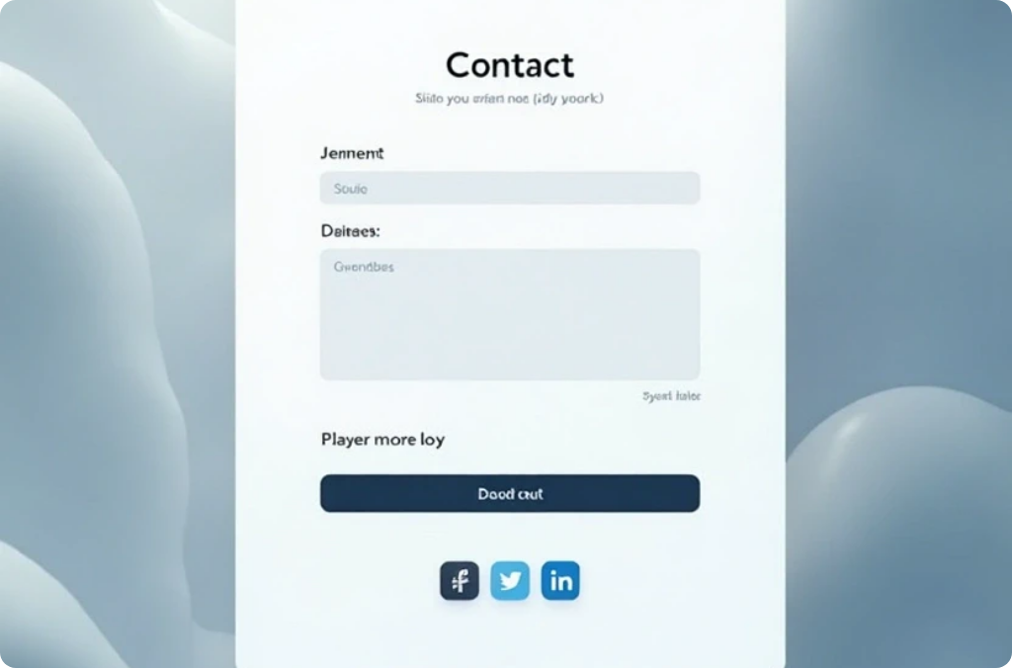


Contact Us Page
Easy Communication
Prompt Responses
FAQs Section
The Contact Us page provides multiple ways for users to get in touch.
Commitment to respond promptly to inquiries is highlighted.
A section for frequently asked questions helps users find quick answers.

Slide 8

Conclusion
Engagement and Growth
Sportify aims to engage sports fans by providing high-quality content and interactive features.
Community Focus
Fostering a community of sports enthusiasts enhances user experience.
Future Developments
Sportify plans to expand offerings and features for better online sports information.

